Slide 2
Programming and Data Analysis for Modern Neuroscience
Spring 2020

Slide 3
Course Objective
The ability to read and write are obvious fundamental skills critical to all academic and quantitative pursuits. Fast approaching this level of fundamental importance is the ability to write computer programs to analyze and manipulate data sets ever increasing in richness and size. This skillset is necessary to work with a wide array of systems whose models and behavior are sufficiently complex to make analysis by hand intractable.
In this course you will translate problems into code applying modern approaches for data analysis, statistical inference and modeling to various levels of neural systems and their component behavior. We will use Python as a coding environment, and you will be exposed to resources and options for scientific computing.
Although geared for neuroscience, the approaches covered in this course are highly salient for a wide array of applications.

Slide 4
Breadth over Depth
We will cover a wide array of topics rather than explore any one topic in great detail. Topics will be introduced at a level where you should be able to understand each concept and put them to use. However, realize up front that we may have only scratched the surface.

Slide 5
Homework
In my opinion there is no better way to learn how to program (or most anything else for that matter) than to do it. Thus, being able to understand and complete the homework yourself is a critical component of making sure you are obtaining the toolset the course aims to give you. This is why homework will be worth at least half if not more of your final grade.

Slide 6
Intro to Programming
Part of a modern scientist’s toolkit.
Programming and Data Analysis for Modern Neuroscience
Spring 2020

Slide 7
Why would you want to add programming to your toolkit?
The need for programming in modern neuroscience.

Slide 8
How would you ____ complex systems & big data?
GWAS
Connectome
RNA-Seq
Multiomics
Models
Time series

Slide 9
How would you ____ complex systems & big data?
GWAS
analyze (efficiently)
Connectome
RNA-Seq
visualize
interpret
test
Multiomics
Models
Time series
understand

Slide 10
How would you interact with data?

Slide 11
A few programming basics.

Slide 12
Programming Languages (not comprehensive)
https://craftofcoding.wordpress.com/2017/01/09/my-periodic-table-of-programming-languages/

Slide 13
Programming Languages
High level
Low level
Human
speech
Python,
MATLAB
C/C++
Assembly
language
Machine
code
Human-readable code that must be compiled into machine code for a CPU.
Human-readable (somewhat) instructions that mostly map to machine instructions.
“For each integer from one to ten, display its value.”
for i in 1:10:
print(i)
for(int i=1; i<=10; ++i){
std::cout << i << std::endl;
}
Binary code that a CPU can run.
for i = 1:10
disp(i);
end
CPU independent
CPU dependent

Slide 14


Code Compilation & Assembly
Source code
Assembly code
Machine code

Slide 15
Compiled vs. Interpreted Languages
Source code
Assembly code
Machine code
Compiled: You do this ahead of time
Compiled:
You pass the machine code around
Interpreted:
You pass the source code around
Interpreted: This happens on the fly

Slide 16
A few rules of thumb.
I highly recommend keeping these firmly in mind for the rest of your programming life.

Slide 17
Being good at programming is NOT simply knowing a lot of programming syntax. It is about:
Understanding a problem conceptually and being able to translate it into code.
Thinking of new ways to tackle a problem and knowing what tools to use.
Knowing how to fix your program when it does not work.
Writing a program that is fast enough, not the fastest possible.
Writing a program that can be understood by other people (or by yourself in a year!)

Slide 18
Basic python in Jupyter notebooks
Jupyter notebook files have extension *.ipynb

Slide 19
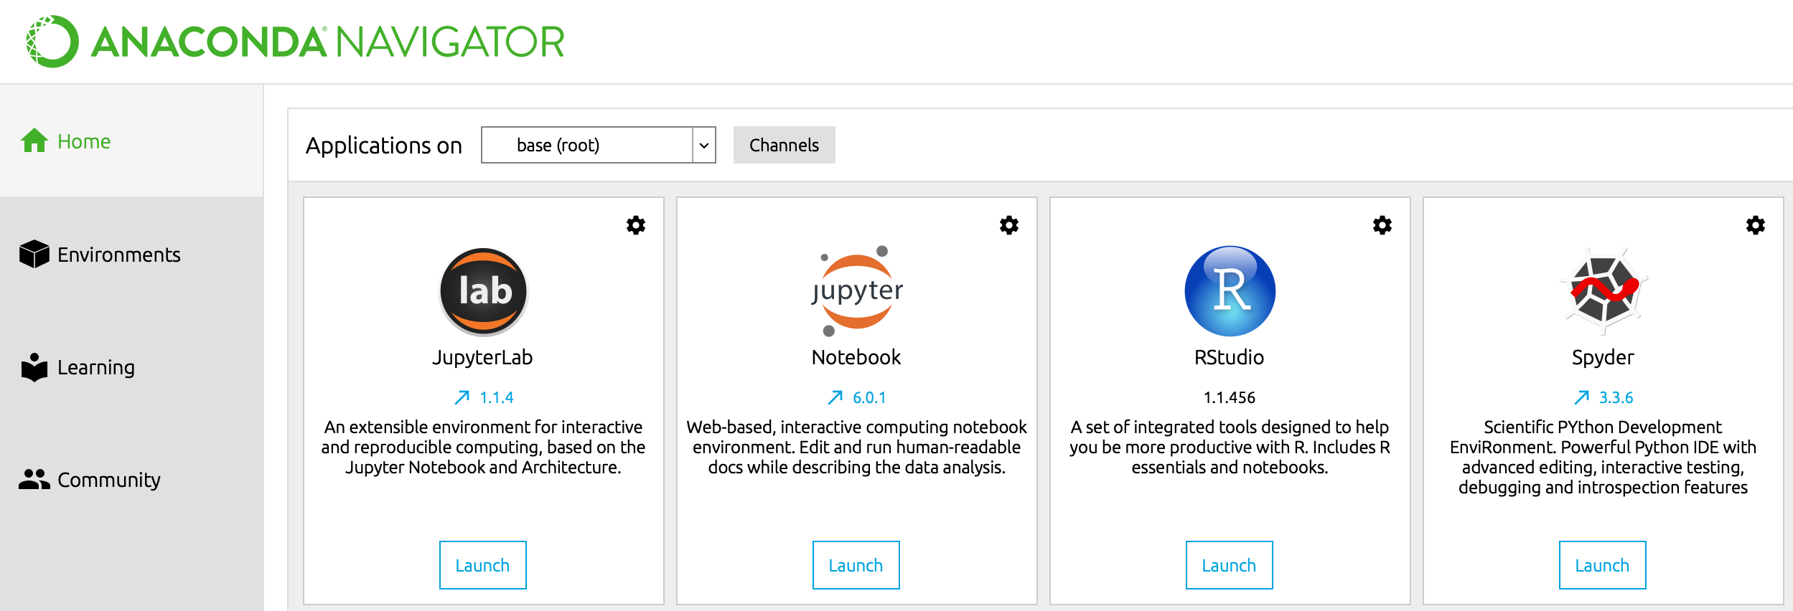
Open Anaconda Navigator and launch JupyterLab.

Slide 20
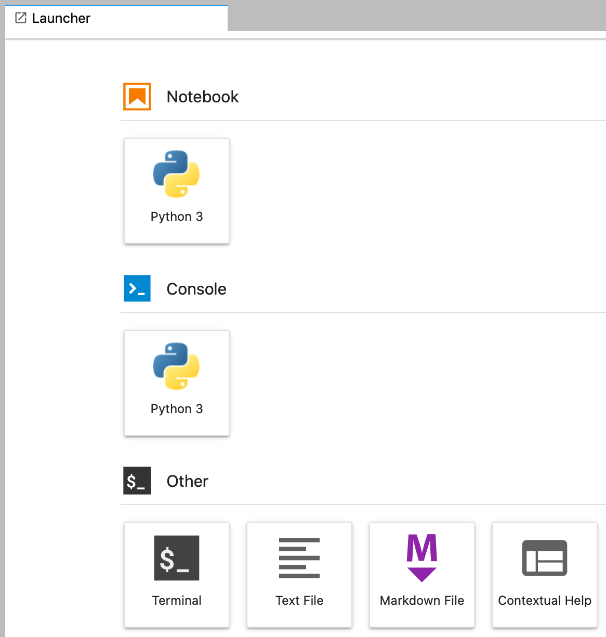
Open a new Python 3 notebook.

Slide 21
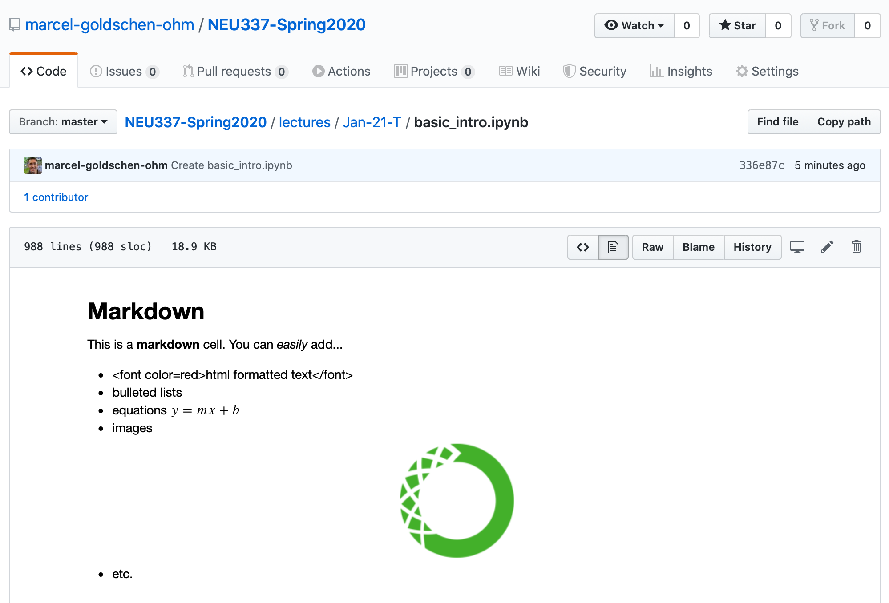
Download the Python 3 notebook basic_intro.ipynb.
Right-click and
Download Linked File
https://github.com/marcel-goldschen-ohm/NEU337-Spring2020

Slide 22
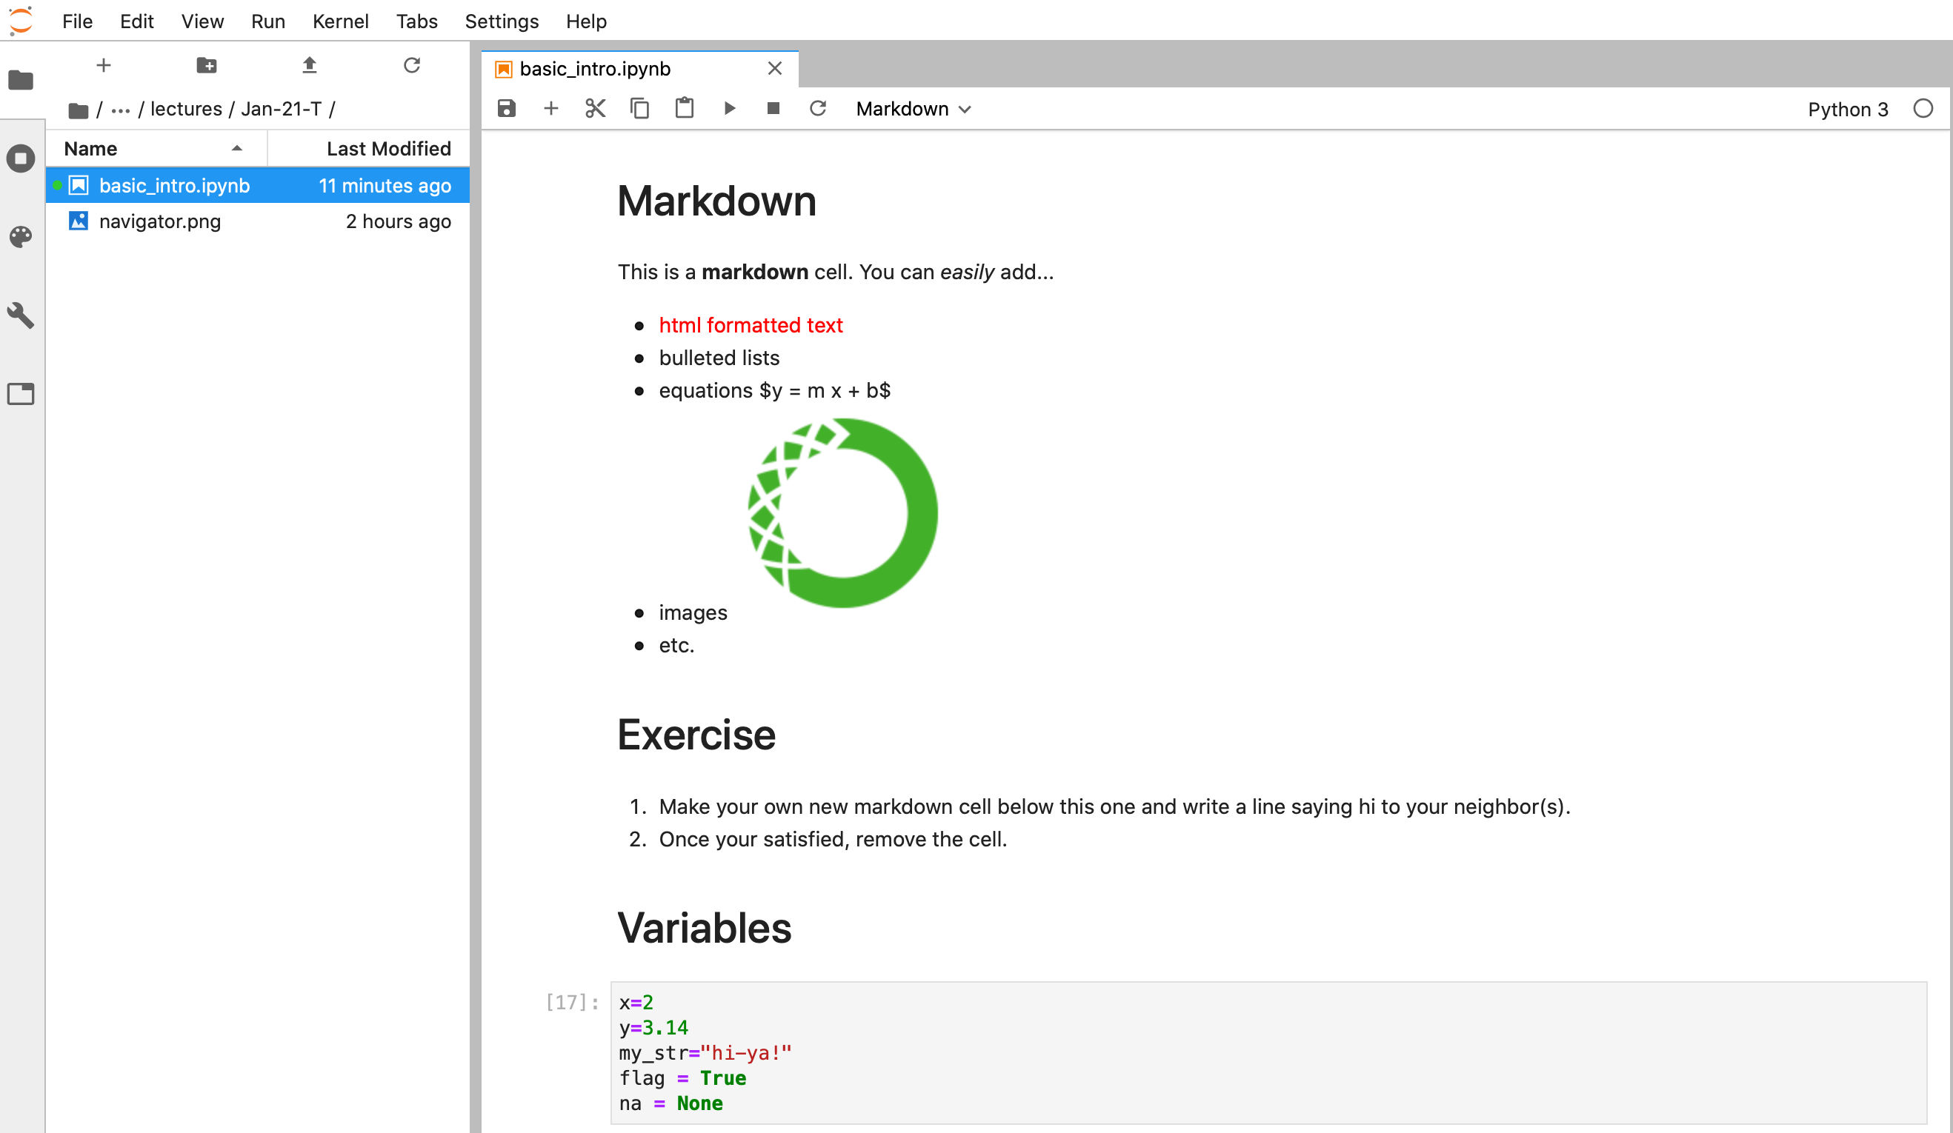
Navigate to and open basic_intro.ipynb in JupyterLab.

